Slide 1
Group Training &
Mentoring Program
4 - 6 Week Program
(Prepared and sent in April - 2023)

Slide 2
Training & Support Program
Overview
This program is designed to develop the style & skills of your staff operating on the telephone. Showing the team easy ways to begin helping clients to buy (rather than trying to sell to them), by increasing their productivity and improving attitudes in the office.
As part of the discovery mission we will look at all telephone activity within your business or team to gain a full understanding of the sales cycle, and the hurdles your team needs to overcome when speaking with clients on the telephone. We then tailor a Telemarketing Masterclass to make sure that everyone gets what they need to increase their confidence and their strike rate. Aimed to give structure, we look to enhance your teams own style and give them back control of their conversations. We will create an action plan to gather all the ammunition we’ll need to perfect the pitch, and begin building a “wish-list” of prospects and strategic partnerships to target.
Materials will be provided for all attendees and this program also includes the
follow up webinar. As discussed, being able to run the session at your own
office will help to keep costs down.
Proposed Date: July 2023

Slide 3
Discovery Mission
Mission overview
(Includes)
A pre-engagement questionnaire for all attendees to fill in prior to my visit. This take less than 10 minutes for them to complete, and allows me to tweak the session to make sure they get everything THEY need from our time together.
A Zoom interview with you and the team leaders to discuss what areas YOU want to address and the issues you see with specific staff. This usually takes 30 – 60 mins.
I will request to see any marketing literature that is being send out to prospects to review, feedback and make some recommendations.
Onsite observation isn’t essential and does cost extra – (Not Included)
2-4 hours in your office to observe calls being made by the team, giving
me a chance to hear "the pitch". This can be done the day before the
workshop and allows me to get a good understanding of what approach
they are taking, plus it helps the rapport building process which in turn
allows me to bring out the best in people.

Slide 4
5 Conversation stears
Preparing to make calls
Getting past the gatekeeper
Dealing with objections
Rapport building techniques
Prospect management
Improving conversion ratios
Motivation and discipline
Workshop overview

Slide 5
Telemarketing Masterclass
Interactive workshop
This half day Telemarketing Masterclass will change the way your team think about picking up the phone. We’ll be looking at the importance of telephone etiquette and how to get permission to speak, while providing a call structure to follow and some techniques to keep them in control of their calls. We’ll then move into a short Live Call Clinic to give everyone time to try things out, before returning for a debriefing session to share any success and create new “best practice” going forwards.
This program can include a take away pack of all the days materials for each of the attendees. You will also receive a hard copy of my book, plus a digital copy of the slide used on the day, which can be utilised for internal use only - to use as a reference tool and helping induct new starters.
This session will be delivered in your office and will run from 10:00am – 4:00pm, usually with one/two short tea-breaks and lunch break.
This session comes with a guarantee that Everyone in the room will walk
away with a "Gem", something useful they could implement straight away.

Slide 6
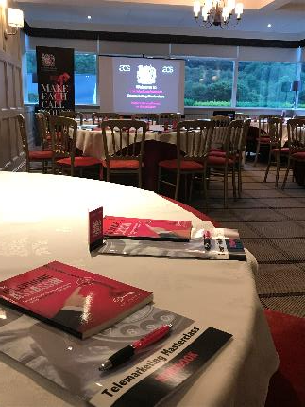
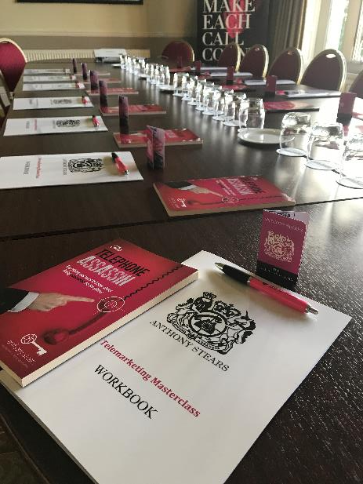

Slide 7
Follow up Webinar & debriefing call
2 weeks later
(approx. 45-60 minutes)
1-2 weeks after the masterclass I will always deliver a remote group follow up session - This is usually conducted over skype or using a teleconferencing service, lasting from 30-60 mins depending on how much extra help is needed (you may record this session if you wish). This gives the attendees an opportunity to discuss what's been happening since our session, sharing any success stories and looking to address any new objections or issues that may be coming up.
(30 - 60 minutes)
Around 1 month after the workshop we will conduct a “debriefing call” (30 mins) to review the performance of the team and discussing if/how best to continue their development. Follow up sessions & “Part 2” can be run in a variety of ways, from doing mini refresher sessions, running a “call clinic” (calling as a group), or 1-2-1 coaching &
monitoring. Some clients choose weekly/fortnightly skype calls or monthly
webinars between visits, but we can discuss how YOU think would work
best at the appropriate time.

Slide 8
investment
Mission Breakdown
Discovery mission – attendee questionnaire , management interviews, literature review and recommendations, excludes onsite observation
Telemarketing Masterclass - This half day interactive workshop includes workbooks, a set of Desk Prompt Postcards, and a copy of my book for each attendee, PLUS a digital copy of all materials used on the day will also provided.
2 x Follow up group calls – 45-60 minute (7 & 14 days after training session) via zoom or videoconferencing system
Debriefing – Video conference meeting to review team performance with the senior management team, to discuss the results and if/how continued support could be delivered.
The Total Investment for this initial 4 stage program would be £3,450, plus
£39.50 per person for all materials, plus any additional travel & expenses.
(Payment Terms – 50% deposit is taken upon booking, and the remaining balance is
due two weeks prior to the onsite visit)

Slide 9
If you have any questions at all
or you would like to
discuss this program please call
Anthony on 07887 798033

