Slide 1
Group Training &
Mentoring Program
‘Lite’ 2 Week Program
(Prepared and sent in March - 2023)

Slide 2
Training & Support Program
Overview
This program is designed to develop the style & skills of your staff operating on the telephone. Showing the team easy ways to begin helping clients to buy (rather than trying to sell to them), by increasing their productivity and improving attitudes in the office.
As part of the discovery mission we will look at all telephone activity within your business or team to gain a full understanding of the sales cycle, and the hurdles your team needs to overcome when speaking with clients on the telephone. We then tailor a 90minute Telemarketing Masterclass to make sure that everyone gets what they need to increase their confidence and their strike rate. Aimed to give structure, we look to enhance your teams own style and give them back control of their conversations. We will create an action plan to gather all the ammunition we’ll need to perfect the pitch and begin building a “wish-list” of prospects and strategic partnerships to target… AND have skills/phrases to prevent pipeline constipation.
A copy of The Telephone Assassin book will be provided for all attendees and
this program also includes a 45 minute follow up webinar. Being able to run
the session at your own office will help to keep costs down and will allow for
a ‘Live Call Clinic’.
Proposed Date: July/August 2023

Slide 3
Discovery Mission
Mission overview
(Includes)
Starting by conducting a “Briefing Call” (usually 30-60 minutes) with any of senior management team that would like to get involved, to discuss the challenges you/your team face, and the goals you’re looking to achieve.
I’ll ask questions about members of the team and we can discuss anyone that may need any special attention on the day, or who might be “harder to work with”. I will also request to see any marketing literature that is currently being send out to prospects to review, feedback and possibly make some recommendations.
From here I can tailor a session to meet everyone’s needs, and we will confirm the venue and running times for the day.

Slide 4
5 Conversation stears
Getting past the gatekeeper
Dealing with objections
Rapport building techniques
Prospect management
Improving conversion ratios
Motivation and discipline
Workshop overview

Slide 5
Telemarketing Masterclass
Interactive workshop
This 90 minute Telemarketing Masterclass will change the way your team think about picking up the phone. We’ll be looking at the importance of telephone etiquette and how to get permission to speak, while providing a call structure to follow and some techniques to keep them in control of their calls. With your permission we’ll finish the session with a 1 hour “Live Call Clinic”, to allow the team to implement the structure and techniques we've been talking about.
This program includes a hard copy of The Telephone Assassin Book for each attendee, plus a digital copy of the slide used on the day, which can be utilised for internal use only - to use as a reference tool and helping induct new starters.
This session will be delivered online and will run for around 3 hours in total, usually with a short tea-break in the middle prior to making calls, and a final debriefing.
This session comes with a guarantee that Everyone in the room will walk
away with a "Gem", something useful they could implement straight away.

Slide 6
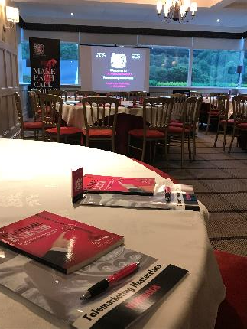
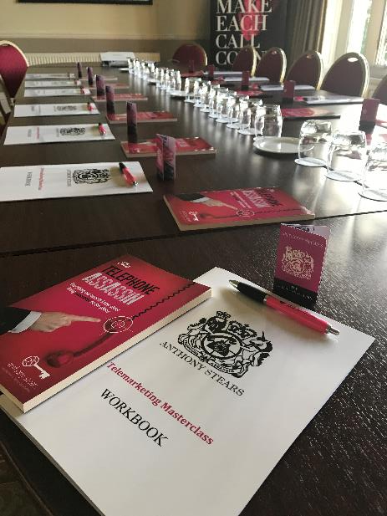

Slide 7
Follow up Webinar & debriefing call
2 weeks later
(approx. 45 minutes)
1-2 weeks after the Masterclass we will always deliver a remote group follow up session - This is usually conducted using Zoom, lasting from 30-60 mins depending on how much extra help is needed (you may record this session if you wish). This gives the attendees an opportunity to discuss what's been happening since our session, sharing any success stories and looking to address any new objections or issues that may be coming up.
(20-30 minutes)
Around 1 month after the workshop we will conduct a short “Debriefing Call” (around 30 mins) to review the performance of the team and discussing if/how best to continue their development. Follow up sessions & “Part 2” can be run in a variety of ways, from doing mini refresher sessions, running a “call clinic” (calling as a group), or 1-2-1
coaching & monitoring. Some clients choose weekly/fortnightly video calls
or monthly webinars between visits, but we can discuss how YOU think
would work best at the appropriate time.

Slide 8
investment
Mission Breakdown
Discovery mission – Management interviews / Briefing Call, literature review and recommendations
Telemarketing Masterclass - This 90 minute interactive workshop includes a copy of my book for each attendee, and a 1 hour Live Call Clinic at the end. Plus a digital copy of all materials used on the day will also be provided.
Follow up webinar – 45-60 minute via Skype or Teleconferencing system
Debriefing – Video conference meeting to review team performance with the senior management team, to discuss the results and if/how continued support could be delivered.
The Total Investment for this initial 4 stage program would be £2,150, plus
£10 per person for the books.
(Payment Terms – 50% deposit is taken upon booking, and the remaining balance is
due two weeks prior to the onsite visit)

Slide 9
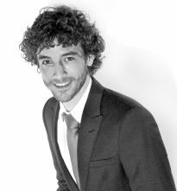
If you have any questions at all
or you would like to
discuss this program please call
Anthony on 07887 798033

